Slide 1
Analysis of Laser Speckle Images
PROFESSOR
Dr . RUSHA PATRA
BY
LENKA AYYAPPA 1801098

Slide 2
INTRODUCTION :
In the last two years, deep convolutional networks have outperformed the state of the art in many visual recognition tasks.
While convolutional networks have already existed for a long time, their success was limited due to the size of the available training sets and the size of the considered networks.
For resolving such issues we present a network and training strategy that relies on the strong use of data augmentation to use the available annotated samples more efficiently.
Using the same network trained on transmitted light microscopy images .

Slide 3
U-Net is more successful than conventional models, in terms of architecture and in terms pixel-based image segmentation formed from convolutional neural network layers.
It’s even effective with limited dataset images. Moreover, the network is fast. Segmentation of a 512x512 image takes less than a second on a recent GPU.
The presentation of this architecture was first realized through the analysis of biomedical images.
Work is to do Tumour Segmentation, Analysis and Classification .

Slide 4
Architecture :
The network architecture consists of a contracting path (left) and an expansive path (right side).
The contracting path follows the typical architecture of a convolutional network. It consists of the repeated application of two 3x3 convolutions each followed by a rectified linear unit and a 2x2 max pooling operation with stride 2 for down sampling . At each down sampling step we double the number of feature channels.
Every step in the expansive path consists of an up sampling of the feature map followed by a 2x2 convolution that halves the number of feature channels, a concatenation with the correspondingly cropped feature map from the contracting path, and two 3x3 convolutions, each followed by a ReLU .
The cropping is necessary due to the loss of border pixels in every convolution. At the final layer a 1x1 convolution is used to map each 64-component feature vector to the desired number of classes.

Slide 5
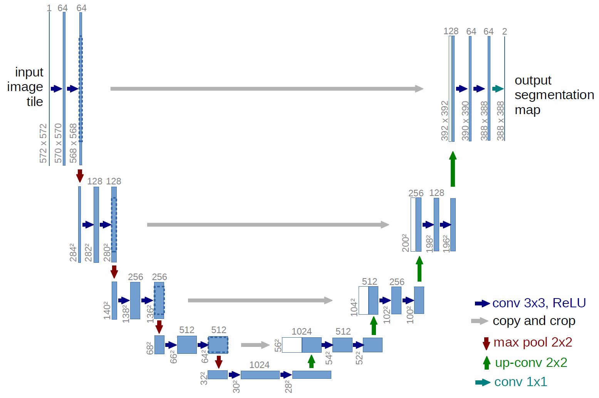
U-NET architecture looks like the letter” ”U’ which derives its name.

Slide 6
Libraries Required :
Keras : This is based on minimal structure that provides a easy way to create deep learning models based on TensorFlow.
NumPy : Using this mathematical and logical operations on arrays can be performed.
OpenCV : This mainly focuses on image processing and analysis including features like face and object detection .
Matplotlib : It is used for data visualization and especially for making 2D plots from data in arrays

Slide 7
Divide your original dataset into two groups, namely training and testing sets. Convert the all of the image data to .tiff format.
Clone git repository
Entering the image folder, which lies within the train folder.
Include the training images in the image folder. Each of the images should be in the .tiff form
Open the main.py file and modify the following class by providing the correct path details. Run main.py file below are obtained results.

Slide 8
Fig1. Train Input Image
Fig2 . Test Input Image
Output 1 for test and train dataset

Slide 9
After obtaining the results of stage1 like ground truth ,prediction by using the test and train dataset we will be doing stage2.
In stage2 we take input as wound segmented images of previous step and output will be the image which is given as ground truth . Here ground truth is used as target output.
Now in that four classes are present and we remove healthy tissue class and background part then we are left with progressive and non –progressive part.

Slide 10
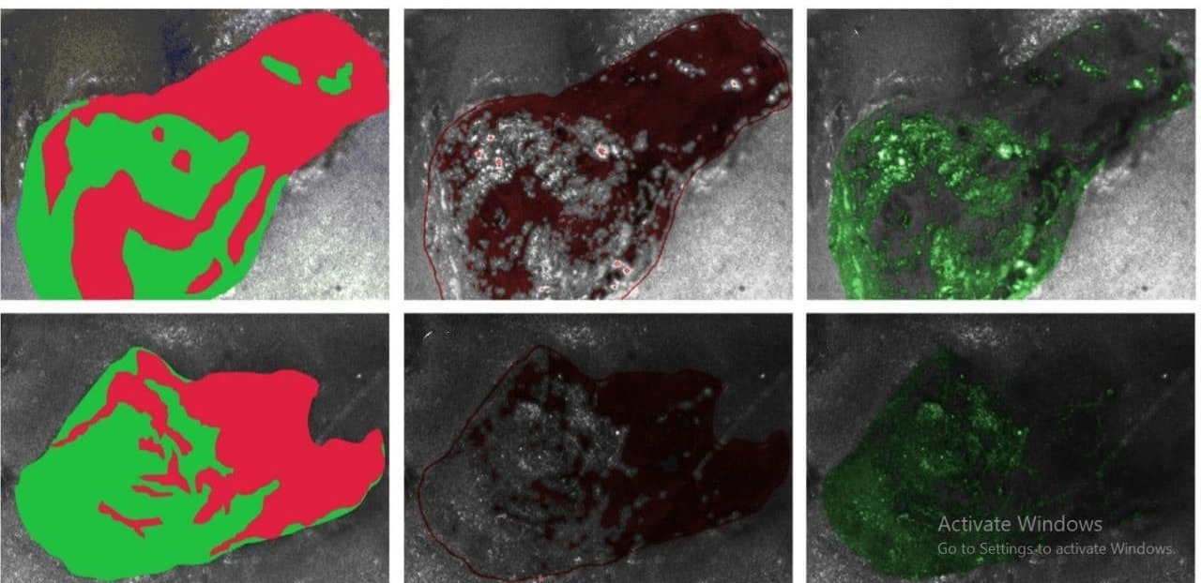
Output 2 . Annotated tissue labels, progressive and non-progressive wound regions for the dataset image respectively. The progressive region is marked in red and relatively non progressive region is marked in green

Slide 11
Loss | Dice Coefficient | Jacard | Accuracy
0.4848 | 0.4953 | 0.3920 | 0.9067
0.4823 | 0.4979 | 0.3315 | 0.9132
0.4813 | 0.4990 | 0.3325 | 0.9248
0.3970 | 0.5015 | 0.3348 | 0.9315

Slide 12
Optimization :
For optimizing the parameters, we used Adaptive Moment estimation ADAM, we minimized the cost function using Adam, which is used to optimize the network at convergence rate.
Conclusion :
We got an overall accuracy of 94.71% on 84 training images and 32 validation images of size 256X256.
We have used binary cross-entropy as the loss function.
It took me approximately 3 hours to train on an 8 GB Windows with a 1.8 GHz Intel Core i5 processor (CPU).
We separated the wound labels into progressive and non-progressive parts using the ground truth.

Slide 13
REFERENCES :
Ciresan, D.C., Gambardella, L.M., Giusti, A., Schmidhuber, J.: Deep neural networks segment neuronal membranes in electron microscopy images. In: NIPS. pp. 2852–2860 (2012)
Learn How to Train U-Net On Your Dataset by Sukriti Paul .
U-NET for Biomedical Image Segmentation –Latent view
U-Net: Convolutional Networks for Biomedical Image Segmentation’ by Olaf RenneBerger et.al.

Slide 14
THANK YOU

